Slide 2
Overview of PNG Forest Products
Good afternoon to you all and a special thankyou to the organisers for the invitation to allow us to provide you with an insight into our business and in particular our involvement with PNG Power in providing private commercial power to the National Grid.
I will start by giving you some history on PNG Forest Products (PNGFP). We are located in Bulolo, Morobe Province, approximately 120 kilometres south-west of Lae.
PNGFP is a large uniquely diversified company with numerous business activities.
The Company's production facilities in Bulolo encompass the manufacture of an extensive range of plywood and timber products made from plantation pine. This includes CCA and ACQ pressure-treated products, including power poles, prefabricated building kits, furniture, and modular bridges. The Company adds further value to its products through its construction division, PNGFP NiuBuild, which operates nationwide, and also the sale of houses under its NiuHomes brand.
PNGFP also has a sales presence in Australia to support its Australian and New Zealand export market for plywood, and sales of engineered timber bridges under its NiuBridge brand. Other export markets include the supply of plywood bus flooring to Malaysia and more recently Ireland.
The company also operates a cattle farm, bakery and retail stores. Its various divisions also include operations in Lae and Port Moresby, and employs approximately 1,120 people.

Slide 3
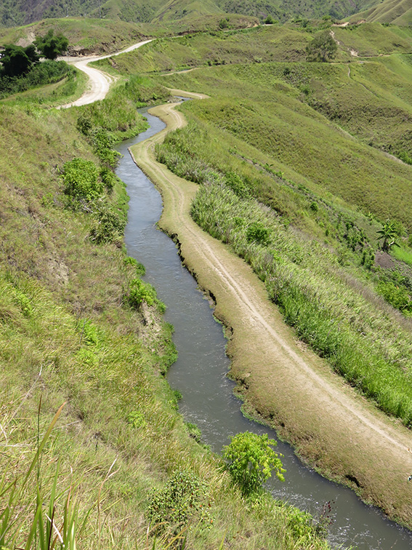
In addition, PNGFP is a major Independent Power Producer (IPP) with three hydro power stations at Baiune with a combined capacity of approximately 15MW, and it supplies the majority of its capacity as bulk power to the PNG Power Ramu Grid. As a licenced Electricity Undertaker PNGFP also retails electricity to local businesses and the general public in Bulolo and the surrounding area.
Lower Baiune power station water race

Slide 4
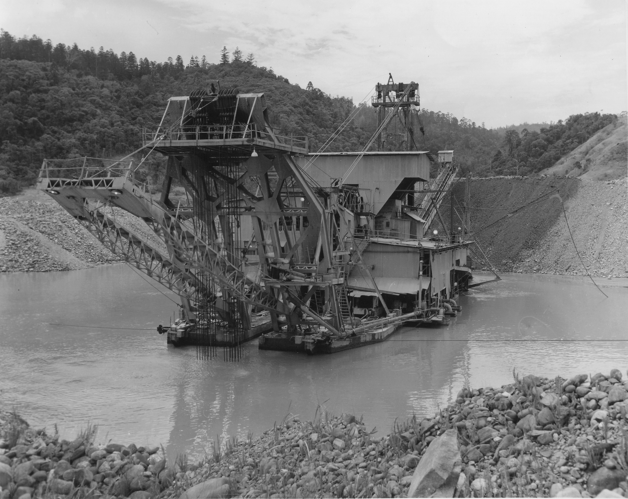
History of PNG Forest Products and hydro power in Bulolo
The history of Bulolo and PNGFP is intertwined with hydro power. To put it simply, Bulolo would never have existed if it was not for reliable hydro power.
PNGFP evolved directly from Bulolo Gold Dredging Ltd (BGD), a mining company that commenced mining operations in Bulolo in 1932 with the launching of the first dredge. BGD was owned by Placer and it operated seven dredges in what was then the world’s largest gold field. These dredges were powered by hydro power stations that remain vital to the area’s industrial activities and general public to this day.
I might add at this juncture for those interested in the gold field history in this region a recent publication called “Not a Poor Man’s Field “ is available from select book shops.
Dredge

Slide 5
In the late 1930’s there were three hydro power stations operating in the Bulolo area with an installed capacity of 7.9MW.
Peak load on the system was 5.4MW.
1. Pine Tops - 2.4MW (Was not rebuilt after WW2)
2. Lower Baiune - 3.5MW (Still operating today)
3. Upper Baiune - 2.0MW (Still operating today)
2.4MW Pine Tops Power Station
Commenced operating in 1932

Slide 6
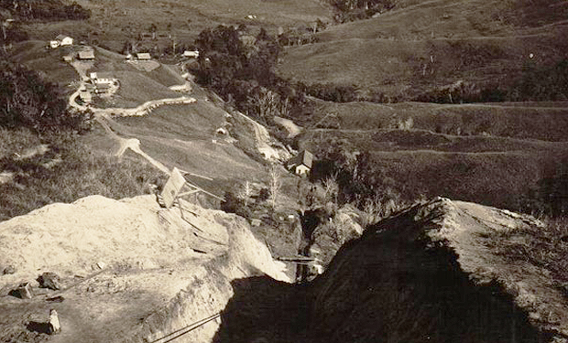
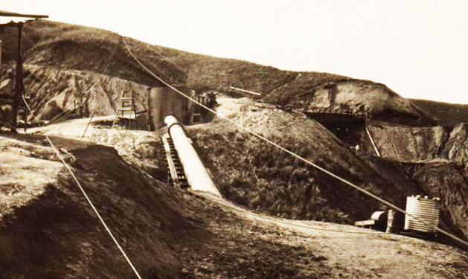
All the infrastructure at Bulolo including the power stations were destroyed by the Australian army during World War 2 as part of their scorched earth policy. The Lower Baiune and Upper Baiune power stations were rebuilt after World War 2.
The Upper Baiune power station was destroyed by fire and rebuilt in the 1980’s, however the Lower Baiune power station has been operating continuously for 72 years since it was rebuilt in 1947. It still operates at nameplate capacity which is testament to generations of dedicated operation and maintenance staff.
Lower Baiune penstock under construction
Lower Baiune surge tank under construction

Slide 7
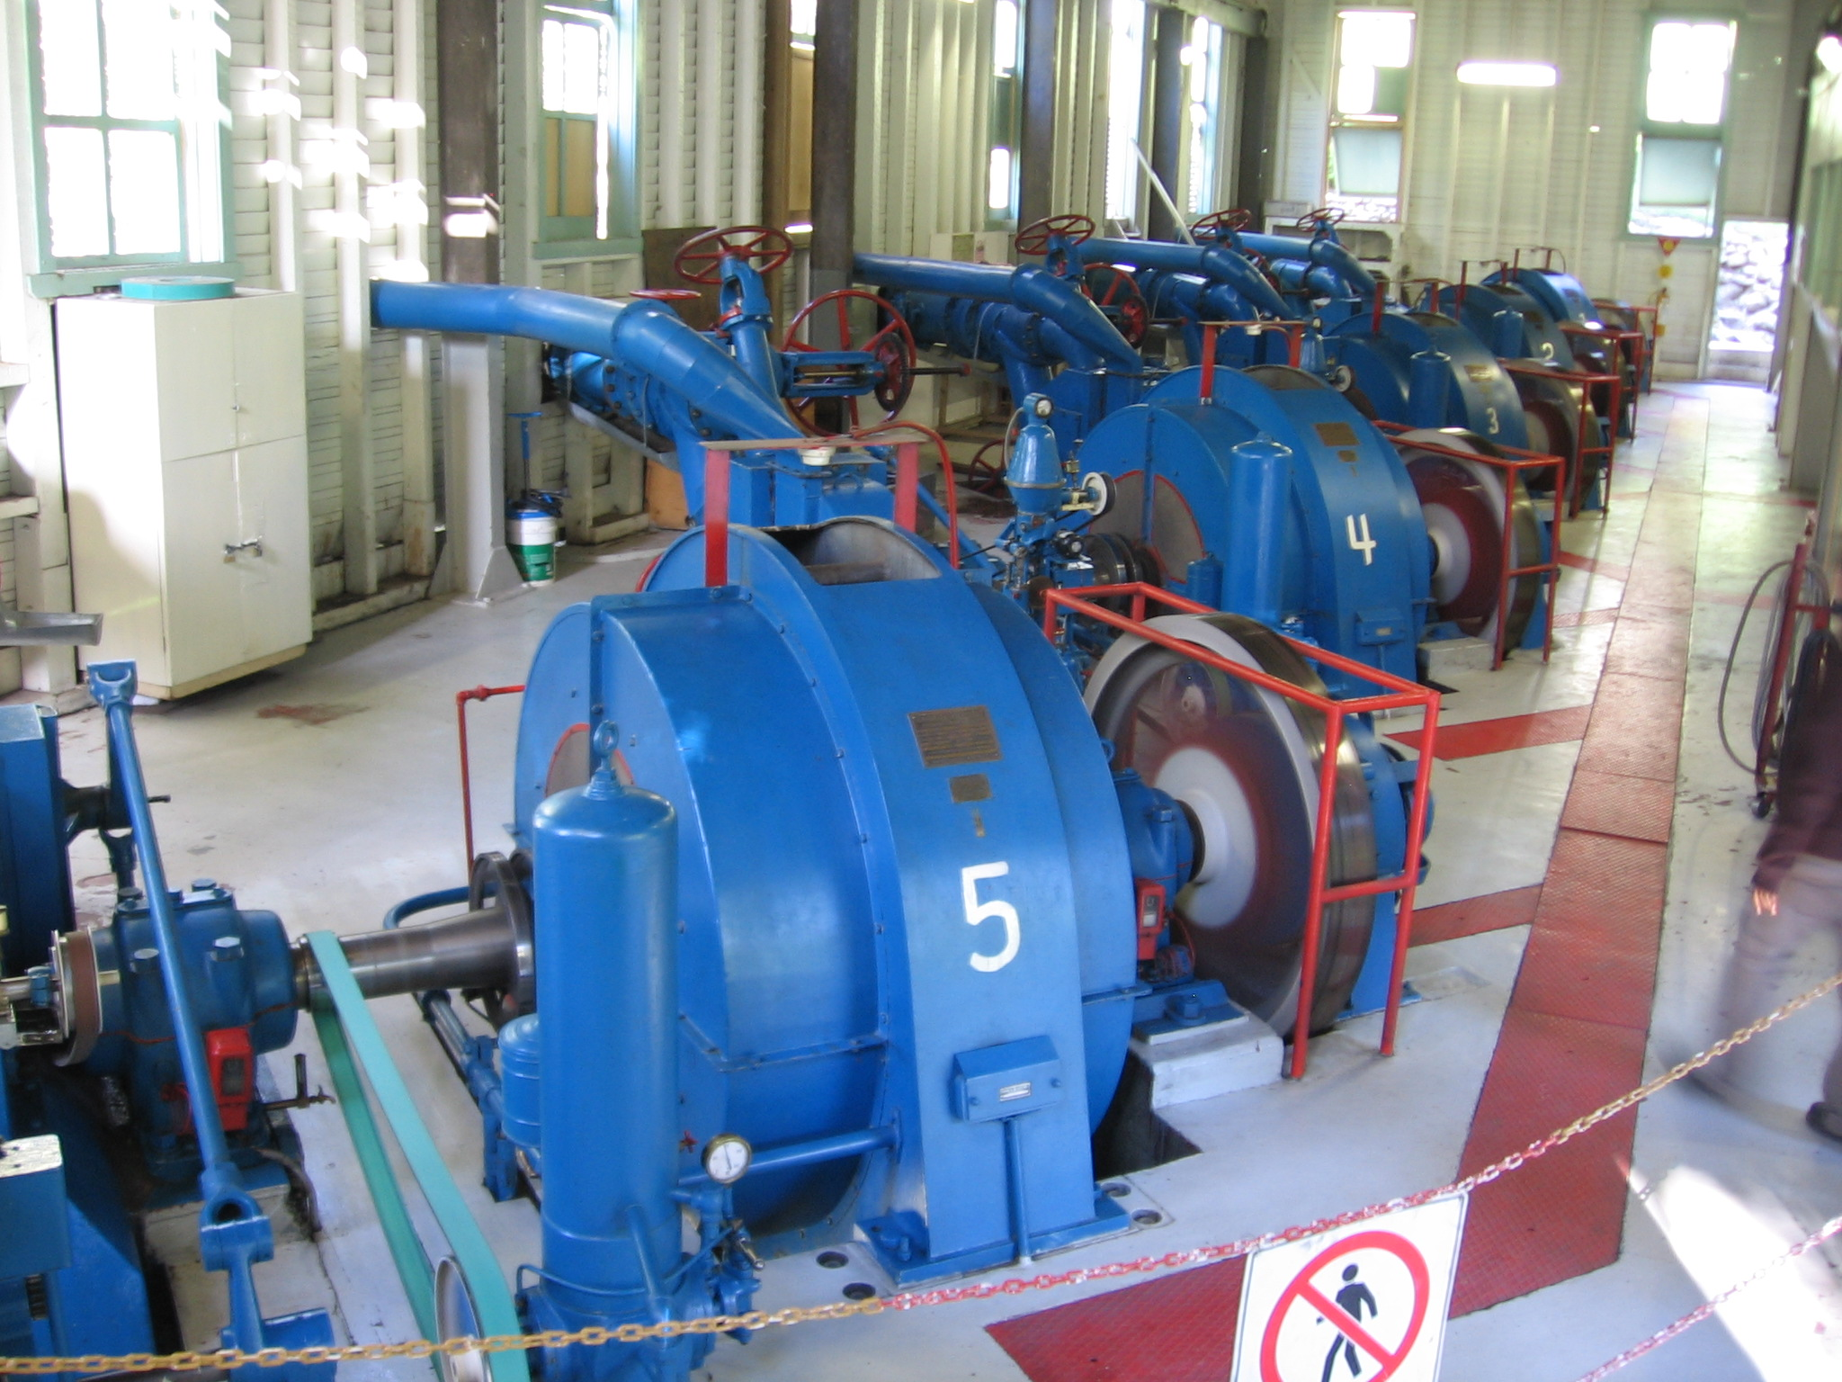
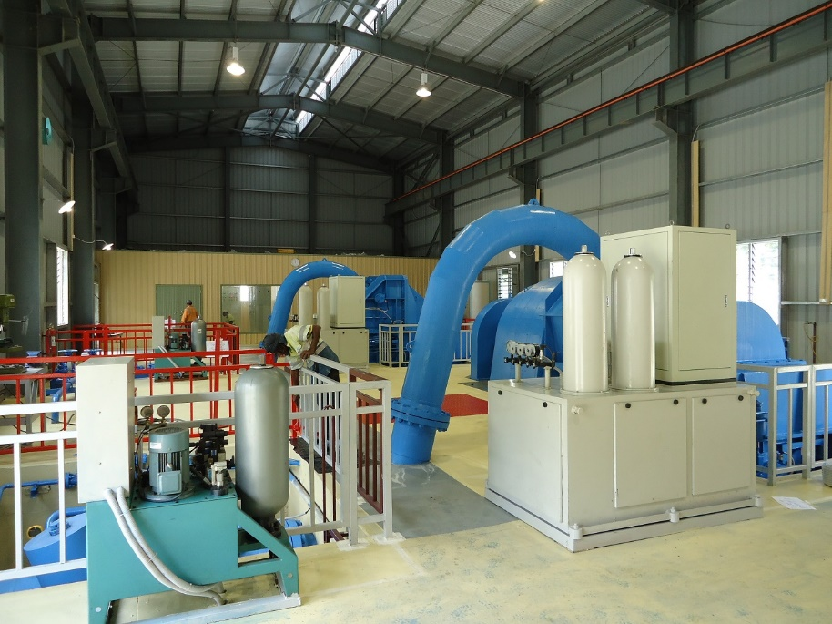
Current Power Stations
From 1947 up until late 2012 the Lower Baiune and Upper Baiune power stations supplied all the power needs of Bulolo and Wau, with surplus capacity being supplied as required to PNG Power (formerly Elcom) from the mid 1960’s onwards.
In December 2012 PNGFP completed the construction of the 9.4MW Upper Baiune power station. This was a major undertaking for the Company and is the first such project in PNG whereby a hydro power station has been built by a private organisation as a commercial venture for the sole purpose of supplying bulk power to PNG Power.
3.5MW Lower Baiune Power Station
9.4MW Upper Baiune Power Station

Slide 8
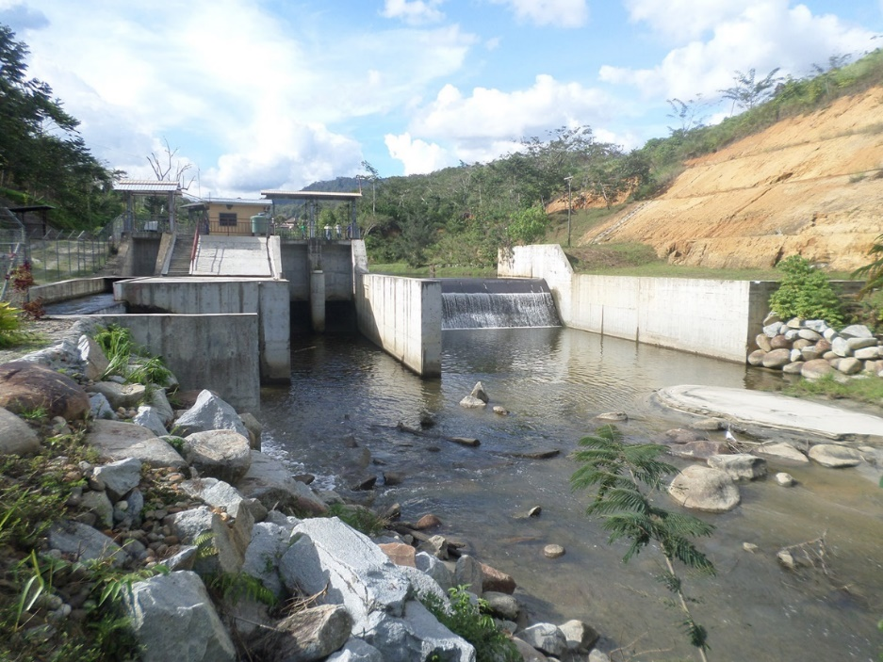
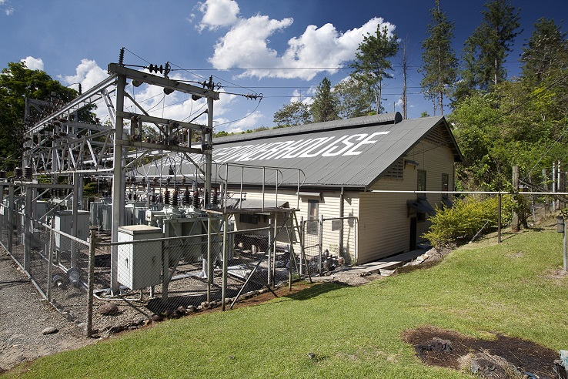
The week-day demand in Bulolo is 3MW and all surplus capacity is exported to the PNG Power grid. This surplus capacity varies according to the Bulolo production load and the river water flow, but it is usually in the range of 9-12MW.
9.4MW Upper Baiune intake weir
3.5MW Lower Baiune Power Station and substation

Slide 9
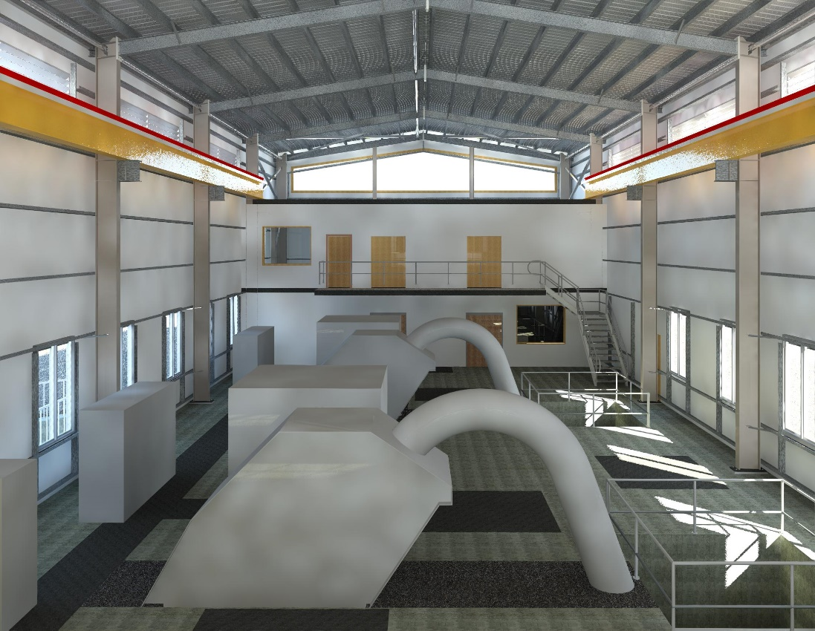
Further Hydro Power Development
PNGFP is well advanced with the development of a fourth hydro power station with a capacity of 11.6MW in an adjoining valley at Baime. The Baime power station will further increase the PNGFP supply to the PNG Power grid. The Pre-Feasibility Study, Feasibility Study and Tender Design have been completed and all necessary regulatory requirements are in place.
Construction is expected to commence towards the end of this year. Commissioning of Baime is scheduled for late 2021. This will increase PNGFP’s hydro power capacity to 26MW, and will increase PNGFP’s supply to the PNG Power grid to over 20MW.
Proposed 11.6MW Baime Power Station

Slide 10
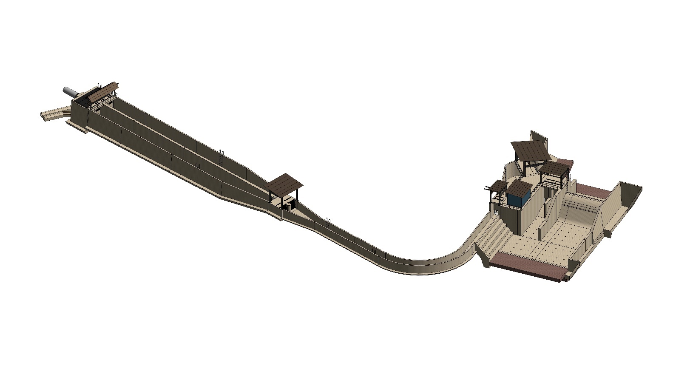
Proposed Baime Headworks
Settling Basin
Collection Chamber and Flushing Conduits
Intake
Diversion Weir
Lateral Spillway
Power Canal

Slide 11
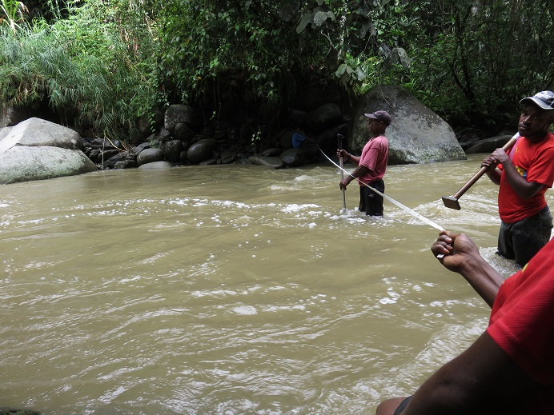
PNGFP is also in the early stages of development of another hydro power project located half way between Lae and Bulolo. PNGFP has a MOA with the customary landowners and SMEC have completed a pre-feasibility study. At this early stage of investigation it appears the site has a potential capacity of approximately 11MW. A PPA with PNG Power is currently in process.
The establishment of a hydro power station has a long lead time from the initial conception stage through to commissioning, and there are many challenges along the way. The process starts with identifying an area with suitable topography, engaging interim agreement with customary landowners for access and general agreement for development is necessary. This is followed by the recording of rainfall and monitoring stream water flow over a period of time as this information does not exist in most areas. Undertaking a prefeasibility study on potential viability is then necessary followed by a conditional PPA agreement being sought and secured. Following this process is a full feasibility study to determine broad costs and real output potential. Securing a Landowner benefits agreement follows which is critical to the overall development. It is not possible to decide to build a hydro power station and just go off and do it, there is so much involved and the process takes several years. PNGFP is a long established company in the region and has had a close relationship with most customary landowners in the area over a long period of time.
Measuring stream flow

Slide 12
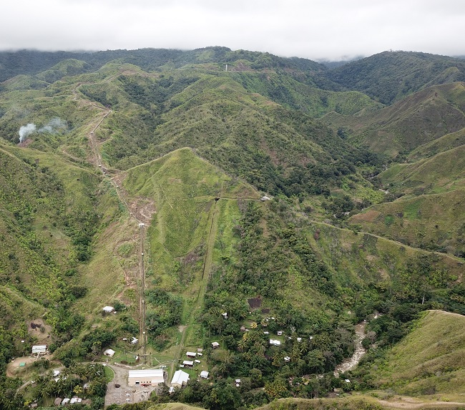
Power station details
All of PNGFP’s current and proposed power stations are of similar design in that they are all high head (high pressure) with Pelton turbines. The high head is available due to the topography of the area in which these power stations are situated, and it enables a high power output for a relatively small stream. The gross head of the power stations are;
2.0MW Upper Baiune station – 137 metres
3.5MW Lower Baiune station – 161 metres
9.4MW Upper Baiune station – 411 metres
Proposed 11.4MW Baime station – 443 metres
Pelton turbines are the most efficient type of turbine at high head and they are also very simple to maintain. They are an impulse turbine and do not have the erosion issues that occur with other types of turbines.
The power stations generate at varying voltages (2.3kV and 6.3kV) and each power station has step-up transformers to step the voltage up to 33kV. The power stations, PNG Power substation and Bulolo are all linked together with a 33kV transmission system.
View of 9.4MW Upper Baiune and 2MW Upper Baiune hydro power stations and penstocks

Slide 13
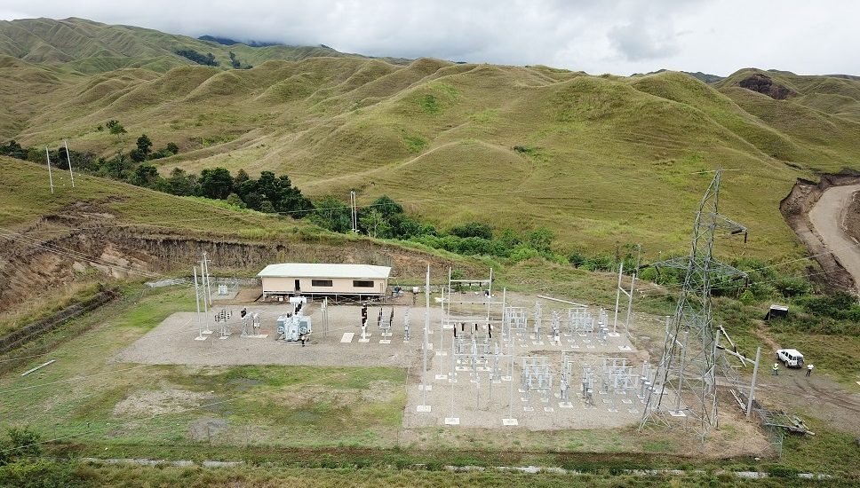
Supply to PNG Power
PNGFP has a long association with PNG Power (formerly Elcom) which commenced in the mid 1960’s when Elcom built a 66kV transmission line to enable Baiune to supply surplus capacity to Lae. At that time Lae relied on diesel generators for its power supply, which was before the PNG Power Ramu hydro station and the Ramu Grid were built.
PNGFP continued to supply power to PNG Power periodically after the Ramu Grid was built.
This arrangement was superseded by the construction of the 132kV Erap to Hidden Valley transmission line which forms part of the Ramu Grid. This line fortuitously goes right past Baiune which enabled the increased capacity at Baiune to be easily connected to the grid. The Baime power station will also connect to the PNG Power grid at the same location.
PNGFP also supplies bulk power to PNG Power at Wau through a separate connection at Pine Tops.
PNG Power 33/132kV Baiune Substation

Slide 14
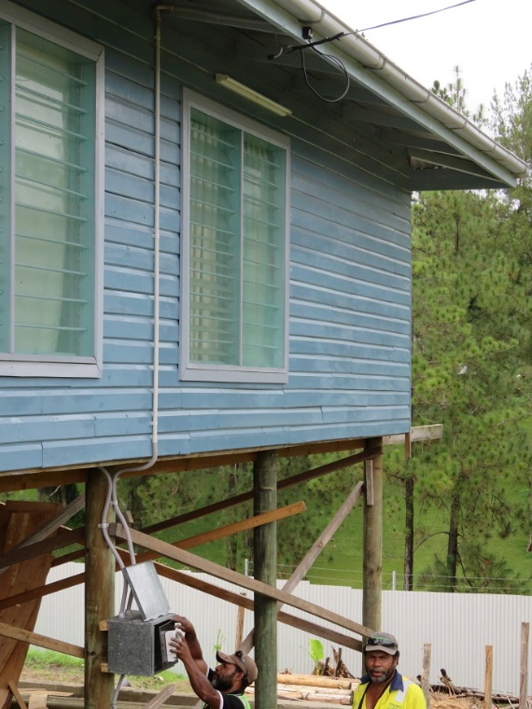
Electricity Licences
PNGFP is a fully licenced Electricity Undertaker and it holds all the Electricity Licences issued by the Independent Consumer and Competition Commission, i.e. Generation Licence, Transmission Licence, Distribution Licence and Retail Licence.
Retail Power
PNGFP distributes power and provides meters to all consumers in the Bulolo and surrounding area that are situated outside of the PNGFP area. With this comes the same challenges as PNG Power faces with retail consumers. PNGFP has recently replaced all the old credit meters with prepaid meters. It is interesting to note that there has been a significant increase in retail power sales since the prepaid meters have been installed. It appears previously many of our consumers were reluctant to use much power because they were concerned about the size of the bill each month and their ability to pay it. Now they can do regular top ups without the worry of a large monthly bill which seems to better suit their lifestyle.
Prepaid meter being installed in a new house

Slide 15
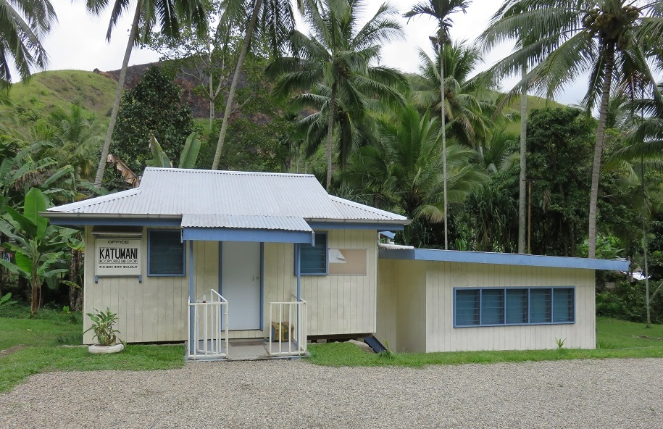
Customary landowners
PNGFP has a very good relationship with the customary landowners in the area where the power stations are located. All the people who are employed to operate the power stations are landowners, except for the two most senior people. In addition to jobs the local people derive substantial benefits under a landowner agreement. The majority of the benefits are provided to landowners as infrastructure development and services in their local area. This also includes education costs for the landowners’ children to attend schools and tertiary institutions. Free power is also provided to the local villages.
A good example of PNGFP’s relationship with its landowners is during the 18 month construction period for the new Upper Baiune power station no time was lost due to landowner issues. This is almost unheard of for a large construction project in PNG.
The new 9.4MW Upper Baiune power station is named Katu Vavini Power Station in honour of the previous landowner chairman who was a great supporter of the project. Unfortunately he passed away three days before the new power station was connected to the grid.
Our landowners are very keen for the Baime project to proceed as they are fully aware of the additional jobs and benefits that will flow their way as a result.
Katumani ILG Office

Slide 16
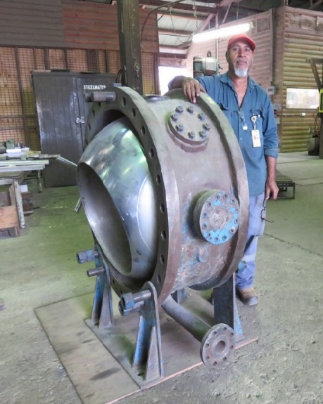
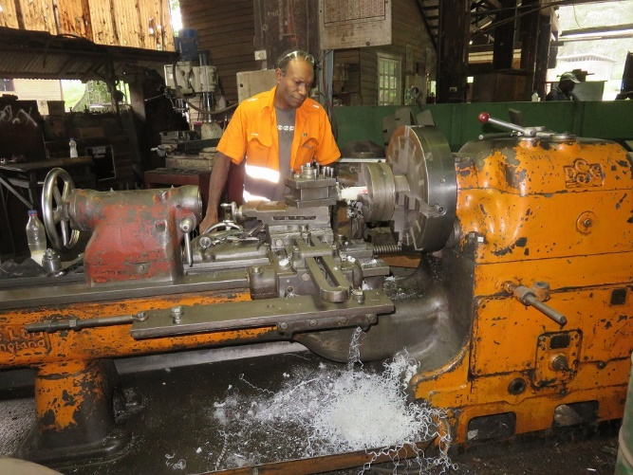
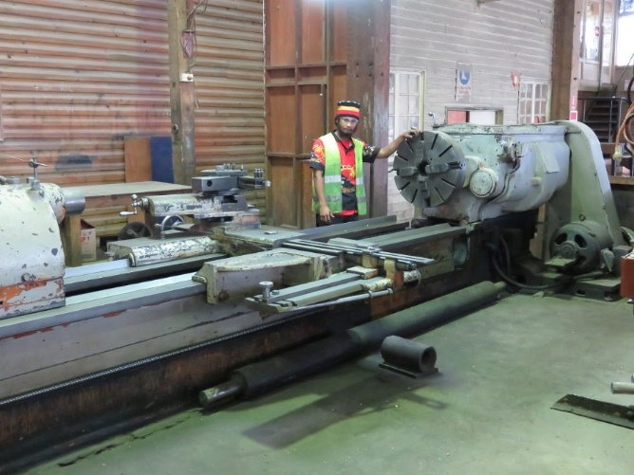
Maintenance
All power station maintenance is carried out in house by PNGFP’s engineering staff based in Bulolo. PNGFP has significant mechanical and electrical departments with well equipped workshops to support the power stations. There is no requirement to engage external contractors for maintenance work.
Machining
Workshop lathe
Turbine main inlet valve
undergoing repairs

Slide 17
Independent Power Producers of Papua New Guinea
PNGFP is a founding member of the Independent Power Producers of Papua New Guinea Industry Group (IP3). IP3 was formed in 2018 as the peak industry group to represent the interests of Independent Power Producers in PNG.
IP3 promotes the electrification of PNG and the development of a sustainable energy industry to power and empower Papua New Guineans. IP3’s mission is to promote the collective interests of Independent Power Producers in PNG, assist with public policy formation and implementation, and serve as a platform for information dissemination to its members, with due regard for the prescripts and limitations imposed by the Competition Act.
IP3 pro-actively engage with legislators, government officials, planners, regulators, PNG Power, and the Business Council of PNG as part of its initiatives to achieve energy security and independence in PNG.
Concluding remark
Ladies and gentlemen this concludes my presentation and I hope what I have provided has given you all an insight into our company business and more particularly an insight into the development and provision of private power to the national grid.
Tony Honey | Managing Director | PNG Forest Products

