Slide 1
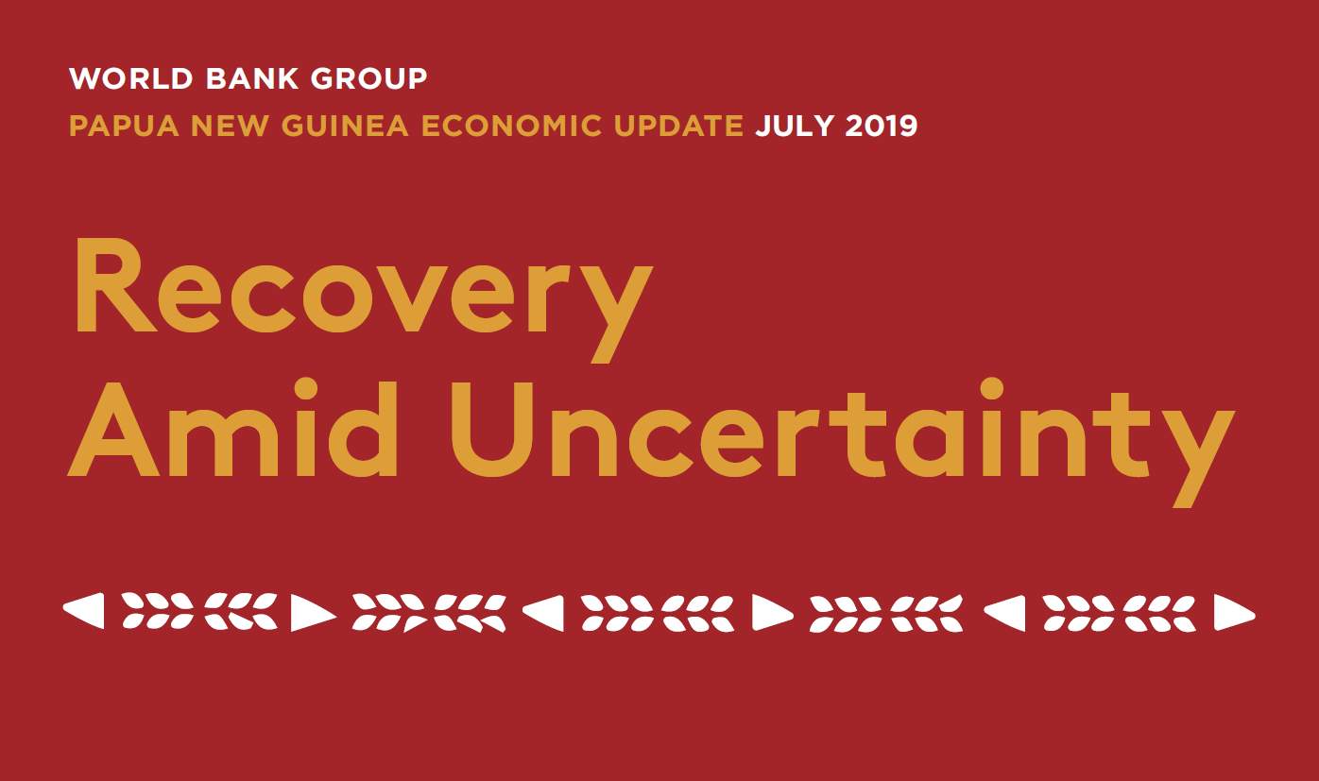
                PNG Investment Conference 2019

Slide 2

Outline
July 2019 PNG Economic Update: Recovery Amid Uncertainty
January 2019 PNG Economic Update: Special Focus: Catalyzing the Private Sector for Inclusive Development

Slide 3
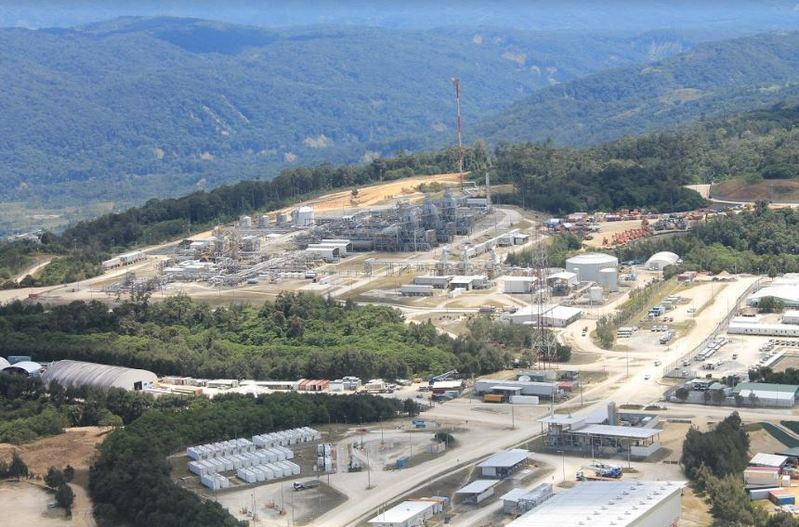
JULY 2019 PAPUA NEW GUINEA ECONOMIC UPDATE
Main Theme:
Recovery Amid Uncertainty

Slide 4
Key Messages:
Recovery Amid Uncertainty
Papua New Guinea’s economy has started recovering; its growth outlook remains positive but fragile due to rising economic uncertainties.
Economic uncertainties are ranging from the domestic political economy to the recent escalation of trade tensions between the United States and China.
To mitigate downside risks and better weather external shocks, the government should adjust its macroeconomic policy and focus on structural transformation of the economy.

Slide 5
After a series of external shocks, growth bottomed out and started recovering
A rebound in extractive-sector production is driving the recovery
Annual percent change in real GDP
FX borrowing helped to build up reserves and address FX issues
US$ millions

Slide 6
The non-extractive economy is
not showing a strong performance yet
Non-extractive exports continue to decline…
US$ millions
…and credit to non-extractive businesses continues to stagnate
Kina, millions
Notes:
Left-hand chart is in US$. Decline in 2018 largely because of palm oil (quantity down 1.2%, prices down 14.1%, sales down 14.4%, )
Right-hand chart in nominal Kina. In real terms credit is falling. Agric, wholesale and retail trade have seen an increase in lending, manufacturing a decline, everything else is flat. Mortgage lending increased 17% in 2018.

Slide 7
Inflation remains low,
Kina depreciation has slowed
Inflation remains relatively low at
4.5 percent in Q1-2019…
Percent change
…perhaps allowing a faster rate of Kina depreciation
Percent change, US$/PGK

Slide 8
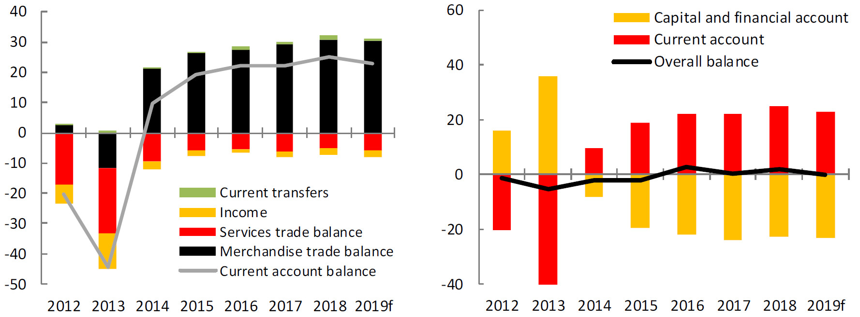
The record high current account surplus is being used to service debt obligations
Merchandise trade performance continued to be strong
Percent of GDP
Higher export revenues are matched by higher debt servicing outflows
Percent of GDP

Slide 9
The 2018 budget required adjustments due to a legacy of budget arrears accumulated
Public-sector wage bill issues are being addressed

Slide 10
The fiscal adjustments slowed fiscal consolidation, contributing to debt
The fiscal consolidation pace slowed as fiscal deficits widened
Percent of GDP / non-resource GDP
Government debt is expected to stabilize in the baseline scenario
Percent of GDP

Slide 11
Transparency for PNG LNG is improving, revealing low revenues received from LNG
Source of PNG LNG Revenues from Commercial Partners, 2017
Percent of total K 350 million reported
K10.5 billion in LNG sales in 2017
K350 million in payments from commercial partners + K300 million dividend from Kumul Petroleum
60% of the K350 million comes as wages and salaries tax
Royalties and development levies only K66 million (0.6% of sales)

Slide 12
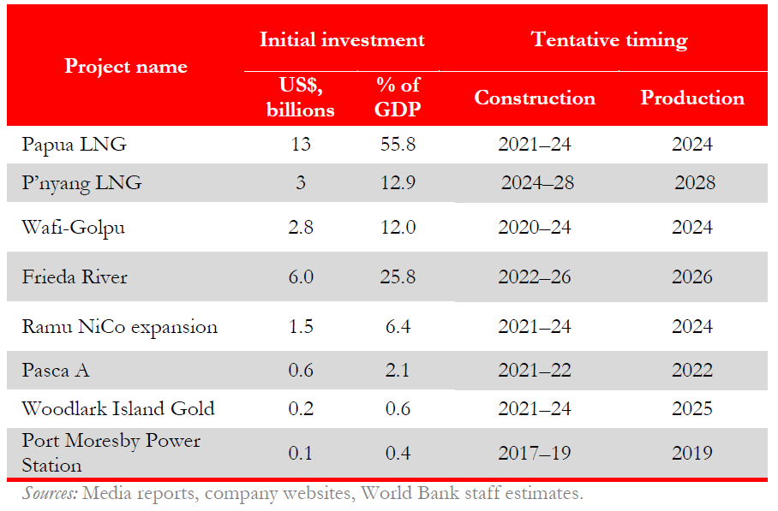
Growing list of resource-sector investments is promising, with uncertain timing

Slide 13
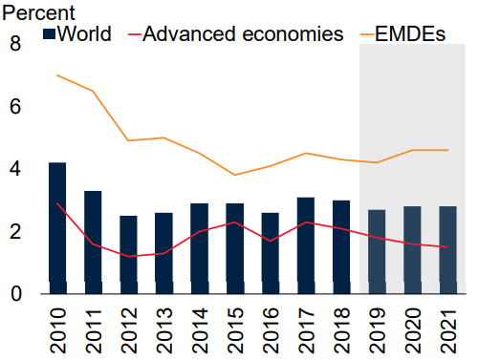
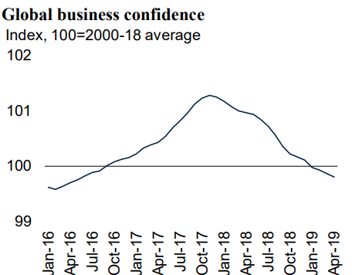
Global outlook: Heightened tensions, subdued investment
Global growth is slowing to 2.6 percent in 2019 — the weakest pace since the global financial crisis
Business confidence is suffering as trade tensions intensify
Notes:
Left-hand chart: Global growth in 2019 has been downgraded to 2.6 percent—0.3 percentage point below previous projections—reflecting the broad-based weakness observed during the first half of the year including a further deceleration in investment amid rising trade tensions. Global economic activity continued to soften at the start of 2019, with trade and manufacturing showing signs of marked weakness.
Amid low global inflation and a deterioration of the growth outlook, the prospect that the U.S. Federal Reserve and other major central banks will tighten monetary policy in the near term has faded, leading to an easing in global financing conditions and a recovery of capital flows to EMDEs. However, weakening external demand has weighed on export growth across EMDE regions.
Right-hand chart: Average business confidence across major advanced economies and EMDEs, including Brazil, Canada, France, Germany, Italy, Japan, Russia, Turkey, the United Kingdom, and the United States. Last observation is April 2019.

Slide 14
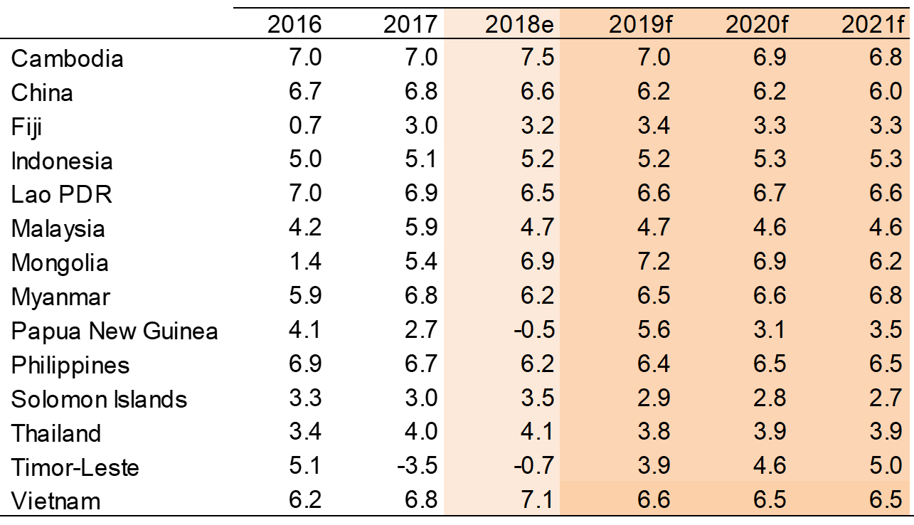
EAP outlook: Growth is expected to drop below 6 percent in 2019-21
East Asia and Pacific real GDP growth forecasts
Annual percent change

Slide 15
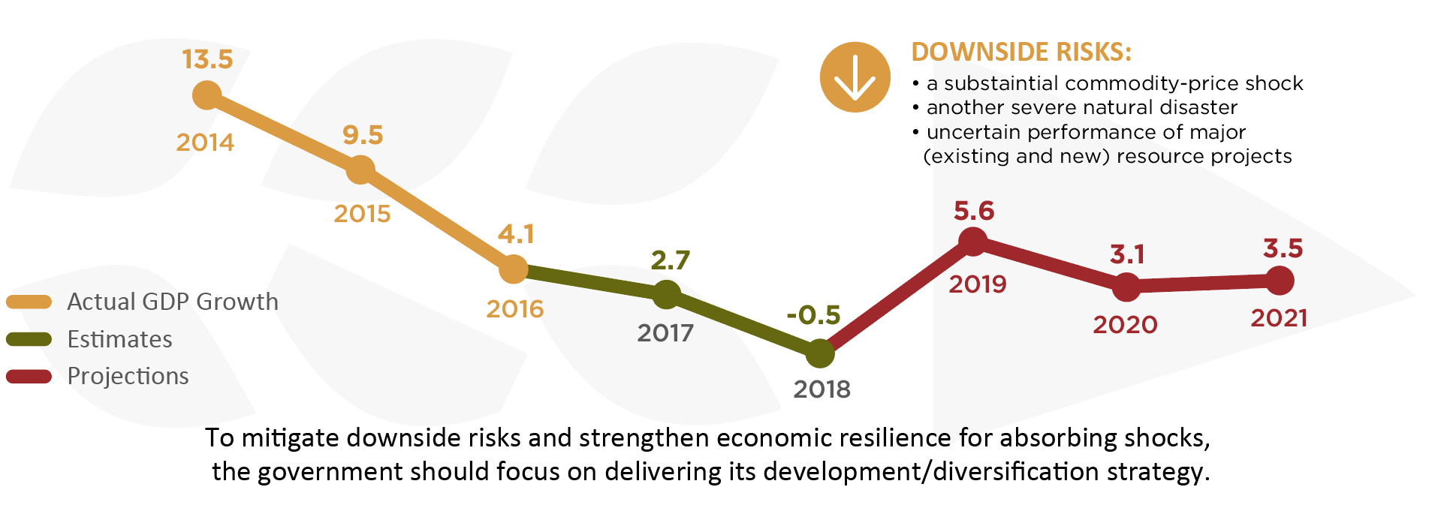
PNG outlook: Positive prospects with certain downside risks
Notes:
Real GDP growth projected to recover strongly to 5.6 percent in 2019 (mainly due to a rebound in the extractive sector), and remain around 3-4 percent in 2020 and 2021.
Downside Risks: external demand and global commodity prices, government failing to implement its fiscal consolidation strategy, terms of future LNG contracts, monetary and exchange rate policy, another natural disaster.
Medium-term outlook is positive, underpinned by further large-scale resource projects, but risks that these projects will be ‘enclave’ in nature and not benefit the wider PNG population.

Slide 16
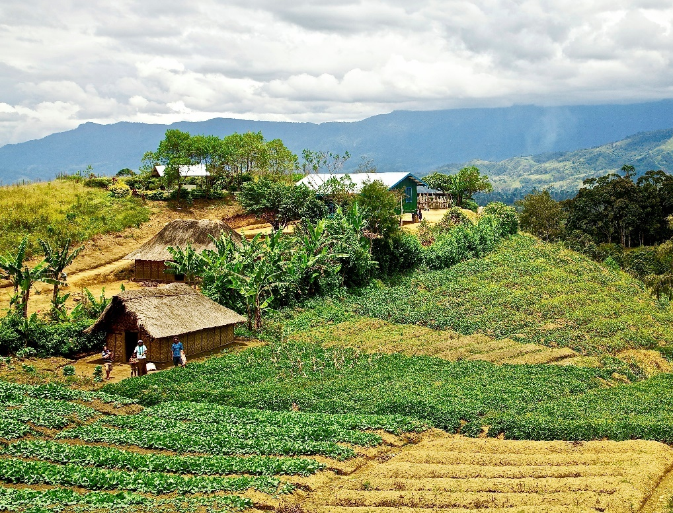
JANUARY 2019 PAPUA NEW GUINEA ECONOMIC UPDATE
Special Focus:
Catalyzing the Private Sector for Inclusive Development

Slide 17
Boosting the non-resource private sector is crucial for long-run prosperity
Private sector development can deliver jobs, inclusive growth, and poverty reduction.
However, PNG’s successful resource sector is capital intensive with relatively limited prospects for job creation.
Inclusive and sustainable growth can only be achieved with success in other sectors of the economy.
Strong potential: PNG’s relatively large land size, population, and natural endowments suggest a broader set of viable economic sectors for private enterprise.
Notes:
Developing the private sector is crucial for job creation and, more generally, for inclusive and sustainable growth.
It is clear, however, that largely foreign-owned and capital-intensive resource sector cannot shoulder these development aspirations.
Efforts need to be focused in the non-resource sector, where most PNG’s are economically engaged, and where the majority of PNG businesses operate.
In the long-run, it is the private sector that will underpin the performance of PNG’s economy and the living standards of its people. But it will need to be a healthy, diversified private sector, that is pursuing viable productive opportunities in a broad range of sectors.
The promising news is that, despite its challenges (and, certainly, there are many; not least of which is a challenging physical geography), PNG’s large size, population, and diverse & extensive natural endowments suggest the potential for a vibrant private sector.

Slide 18
The non-extractive private sector’s potential has yet to be realized
The private sector in the non-resource economy is characterised by:
Small firm size
High informality
Low foreign direct investment
Limited export diversification
Significant and widespread obstacles to doing business
Poor business conditions make it difficult to attract foreign investment
Foreign direct investment, net inflows
(% of GDP, 2008–17 average)
Notes:
Despite the private sector’s significant potential, we see that it is characterized by these following aspects…
Small size → firms seem unable to exploit economies of scale; implies the most successful firms are not growing and employing more people.
Informality → not finding it worthwhile to comply with regulatory environment; not paying tax; not abiding by labor regs; will face difficulties accessing public amenities as well as finance.
Non-extractive FDI → low investor confidence; reduced opportunities to expand; reduced transmission of technologies and techniques from overseas; lower competition.
Limited export diversification → As at 2018, 87% from extractive sector; 11% from agriculture, forestry and fisheries (6% agriculture; 3% forest products; 2% marine products).
Obstacles → The set of challenges is diverse. This will be expanded on in the next slide.

Slide 19
Doing Business indicators compare well, but limited reliability in the PNG context
PNG’s ranks around the middle of comparator countries
Doing Business, overall percentile rank, 2019
PNG underperforms on some business environment indicators, but outperforms on others
Doing Business indices, percentile rank, 2019
Notes:
The ‘de jure’ nature of the survey. Approximately two-thirds of data used in constructing the indicators are based on a reading of the policy/law.
It is obvious that getting credit and getting electricity aren’t really as good as what the LHS diagram suggests.
We constructed these diagrams by taking country scores (not ranks) and then computing their relative percentile ranks.

Slide 20
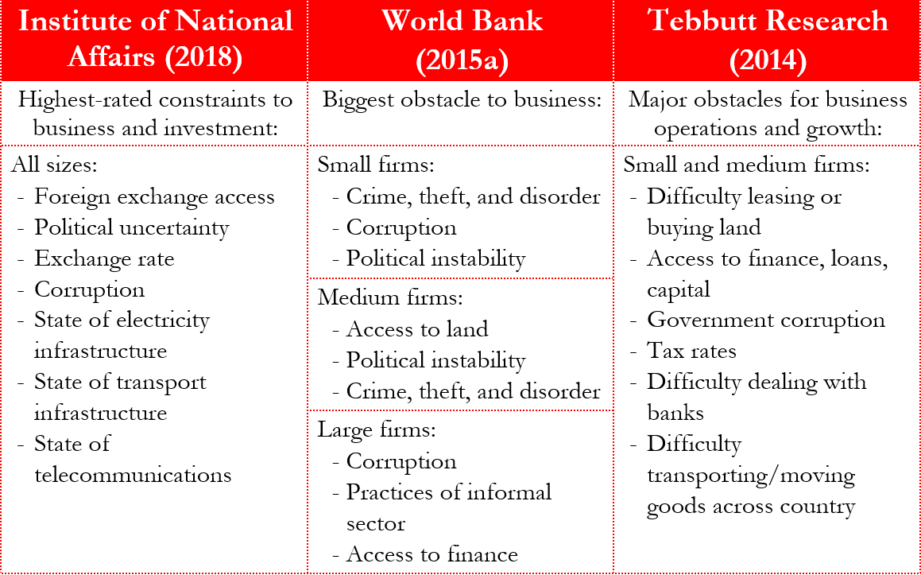
Business surveys reveal a broad range of obstacles to operations and growth
Notes:
Revitalizing PNG’s private sector will require addressing the ‘pain points’ that businesses are facing.
infrastructure, foreign exchange, finance, land, law enforcement, and skilled labor; corruption;
policy and regulatory uncertainty (this is not mentioned in the table, but perhaps reflected in political uncertainty and instability; over 80% of firms in 2017 had concerns over stability of rules, policies and regulations).
In our report, we take a closer look at these issues. Most will come as no surprise, as they are not new to PNG. For instance, the country’s diverse geographic terrain and dispersed population have always meant that infrastructure provision will be challenging. Moreover, these aren’t typically things that can be fixed immediately - they will require deliberate efforts over the medium term.

Slide 21
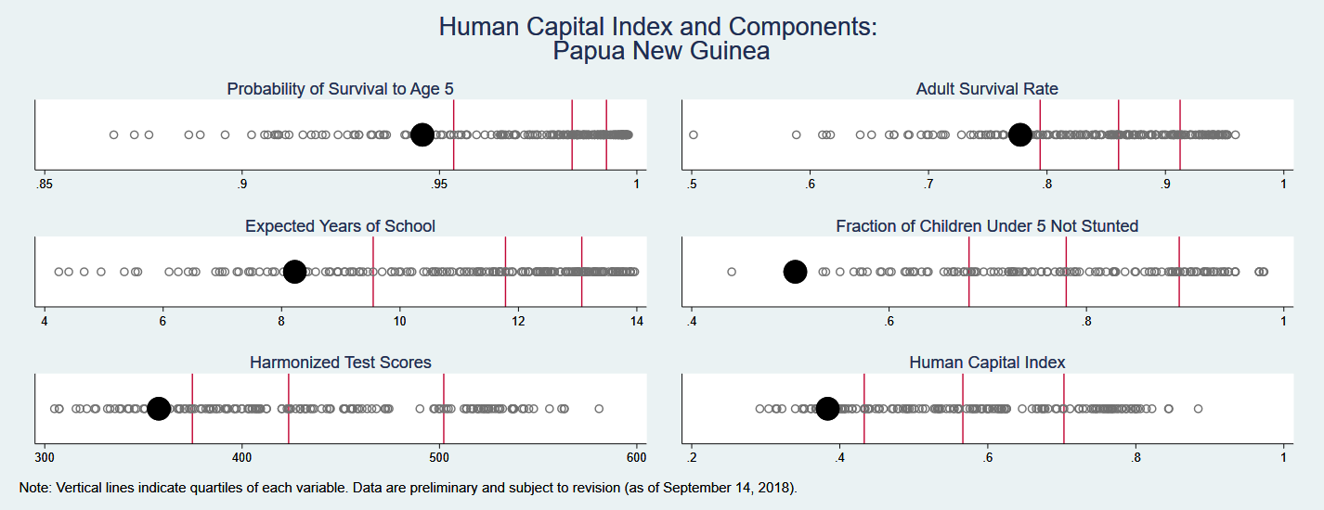
PNG performs poorly in the human capital index
Notes:
Young and growing population: 53.8% of the population were 25 and under in the 2011 census – 18% between the ages of 15-24. The youth bulge, and high population growth (3.1% per annum), has increased pressure on service delivery and will continue to do so as the population ages. Investing in PNG’s young population will support future growth and development.
High rate of poverty: Improvements in human capital will further assist the 38% of the population who live below the international poverty line of $1.90 per day (UNDP, 2015).
High rates of under- and unemployment: Greater and more effective spending on human development will prepare PNG’s labour force for the future, will provide opportunities in formal employment (currently less than 15% of the total labour force).

Slide 22
Human capital development agenda requires focusing on sectoral reforms
Roll-out Provincial Health Authorities to consolidate health financing and service delivery with a focus on enhancing the frontlines of service delivery.
Improve value for money, in line the National Education Plan (2015-2019), continue education reforms to improve quality of education.
Use technology to establish high quality data systems on human capital inputs, outputs and outcomes at subnational levels.
Enhance water and sanitation infrastructure and access.
Establish the national and provincial multi-sectoral coordination mechanism to provide leadership, oversight and accountability for implementation of the National Nutrition Policy, 2016-2026.
Implement the cross-government National Population Policy (2015-2024).
Notes:
A skilled workforce will be able to meet future demands across the economy and increase country and individuals earnings
Investments in childhood development and nutrition in the early years has the potential to release large dividends for the country, communities and households

Slide 23
Key opportunities for jobs-laden, inclusive growth in the private sector
Opportunities exist to leverage local advantages and untapped potential in the agriculture, fisheries, and tourism sectors
These sectors have the potential to:
  support rural livelihoods and food security
  provide suitable employment opportunities for PNG’s unskilled and semi-skilled labor force
  create relatively more jobs for women & youth
  improve rural-urban economic linkages
Notes:
In addition to taking a horizontal perspective on business environment constraints in PNG, our report also conducted a deep dive into three key economic sectors which hold considerable local advantages and untapped potential for jobs-laden, inclusive and sustainable growth – outside the extractive sector.
The final bullet point about rural-urban linkages may be less/not true for tourism. The same applies to food security.

Slide 24
The bottom line
PNG’s long-run economic fortunes are inextricably tied to the success of its non-resource economy.
Wide-ranging structural reforms are needed to increase the quality of human capital and improve the business environment.
Improved consultation with all stakeholders is required to identify and address the most significant obstacles.
Specific opportunities exist to leverage local advantages in strategic sectors with the potential for significant job creation and other development outcomes.

