Slide 1
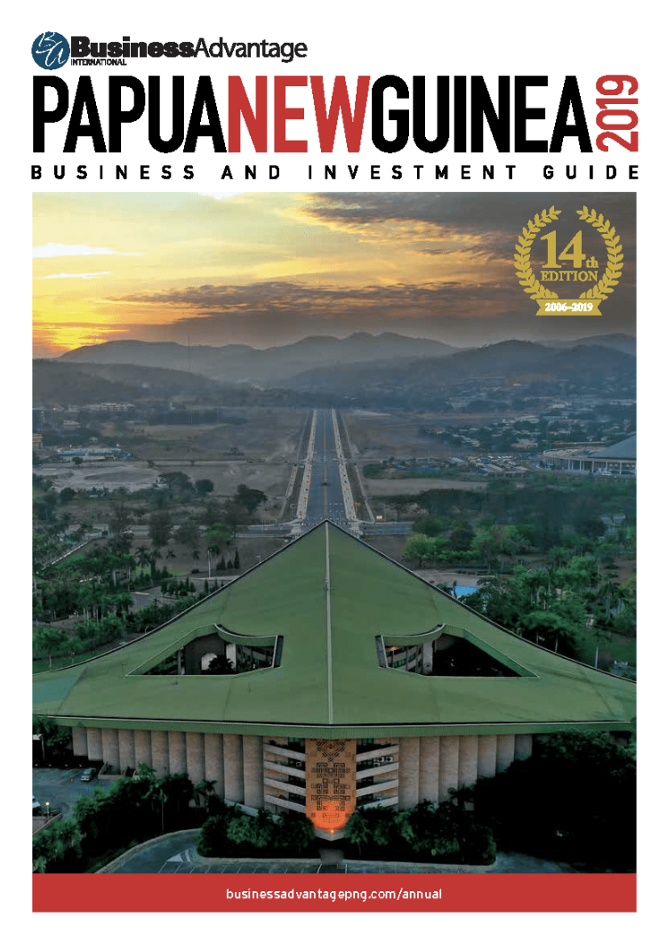
The PNG 100 CEO Survey 2019
Business confidence survey of PNG’s largest businesses
Now in its 8th year
Also canvasses key challenges faced by businesses in PNG
Results published in Business Advantage Papua New Guinea annual business and investment guide

Slide 2
2019 results
Profit expectations
last year
Notes:
Profits patchy
Twelve months ago, when we asked the CEOs what their profit expectations were for 2018, they were cautiously optimistic. About two-thirds were positive: half thought profits would ‘somewhat’ exceed the levels of 2017 and 15 per cent expected that they would be up ‘substantially’.
A year on and those expectations were broadly met.
More than half (56.7 per cent) said their performance was better than expected, with 10 per cent saying profits were up substantially (although this figure was down on the 15 per cent the year before). The number of respondents who said profits slightly exceeded expectations (46.7 per cent) was just over double the level in the previous year.
Thirty per cent said profits were in line with expectations, up from a quarter the previous year.
On the negative side, 13.3 per cent said they fell slightly short of expectations. Nobody said profits fell substantially short of what was hoped—an improvement on the previous year, when 6.2 per cent were in this category.

Slide 3
2019 results
Profit expectations
this year
Notes:
What will 2019 bring?
With some signs of economic recovery, it is not surprising that business leaders are reasonably bullish. More than three quarters (76.6 per cent) believe that profits will rise this year, up from 65.6 per cent figure in 2018.
The number of CEOs who expect profits to be substantially up was also higher: 23.3 per cent compared with 15.6 per cent in the previous year.
A tenth believe profits will be worse, while 13.3 per cent believe they will be the same, compared with a quarter in the previous year. Once again, no CEOs expect ‘substantially’ lower profits.

Slide 4
2019 results
Planned investment
this year
Notes:
Profits patchy
Twelve months ago, when we asked the CEOs what their profit expectations were for 2018, they were cautiously optimistic. About two-thirds were positive: half thought profits would ‘somewhat’ exceed the levels of 2017 and 15 per cent expected that they would be up ‘substantially’.
A year on and those expectations were broadly met.
More than half (56.7 per cent) said their performance was better than expected, with 10 per cent saying profits were up substantially (although this figure was down on the 15 per cent the year before). The number of respondents who said profits slightly exceeded expectations (46.7 per cent) was just over double the level in the previous year.
Thirty per cent said profits were in line with expectations, up from a quarter the previous year.
On the negative side, 13.3 per cent said they fell slightly short of expectations. Nobody said profits fell substantially short of what was hoped—an improvement on the previous year, when 6.2 per cent were in this category.

Slide 5
2019 results
Planned recruitment
this year
Notes:
Recruitment intentions are more conservative but still positive. More than half (53.3 per cent) expect to increase staffing levels, while 13.3 expect a sharp rise (slightly up from 12.5 per cent per cent in the previous year).

Slide 6
2019 results
Impediments
right now
Notes:
While access to foreign exchange features again as a significant issue faced by PNG’s major businesses, it is superceded in this year’s survey by unreliable telecommunications, which is listed as the top impediment for the first time in eight years of our survey. It also implies that the Coral Sea Cable System, to be introduced in early 2020, will have a big impact on business in PNG. Foreign exchange is nominated by 63.34 per cent of respondents as a first order issue, down from 71 per cent in the previous year. It is considered ‘mission critical’ by 36.7 per cent of respondents, down from 41.9 per cent in the previous year.
Unreliable telecommunications was rated even higher than foreign exchange, with 83.4 per cent ranking it as a first order issue and 36.7 per cent saying it was ‘mission critical’. Other issues considered mission critical are: shortage of expertise and skills (30 per cent, up from 22.6 per cent the previous year), security and law and order (23.3 per cent, up from 9.7 per cent the previous year), and lack of government capacity (16.7 per cent, down from 22.6 per cent).

Slide 7
The PNG 100 CEO Survey 2020
Survey commences Q4 2019
Results published February 2020
Future expansion

